Slide 1
Software Reverse Engineering
Module A3 – Forward Engineering
Notes:
This slide deck is part of Software Reverse Engineering.
The context of this slide deck in shown below.
Part 0 – SRE in Context
Part A – SRE Prerequisites
Module A1: x86 and x64 Architectures and Assembly Languages
Module A2: ARM Architectures and Assembly Languages
** Module A3: Forward Engineering
Part B – Philosophical Approaches to SRE
Module B1: Approaches to SRE
Part C – Static Analysis for Binary SRE
Module C1: File Handling Techniques
Module C2: Basic Static Analysis Tools
Module C3: Disassemblers and Decompilers
Part D – Dynamic Analysis for Binary SRE
Module D1: Sandboxing and Other Techniques
Module D2: Basic Dynamic Analysis Tools
Module D3: Debuggers
Module D4: Network Traffic Analysis
Module D5: Patched Binaries
Part E – Obfuscation and Anti-SRE
Module E1: Obfuscation and Anti-SRE
Part E – Non-Binary SRE
Module F1: Non-Binary SRE

Slide 2
Table of Contents
Introduction
Preprocessor
Compiler
Assembler
Linker
Summary
Notes:
These are the topics that are covered in this lesson.

Slide 3
Introduction: Module A3 – Learning Objectives
Upon successful completion of this module, the student should be able to:
Explain how binaries are built (including preprocessing, compiling, assembling, and linking)
Recognize and differentiate between basic programming language structures in assembly language
Design and implement assembly language programs with structures.
Notes:
These are the learning objectives for Module A3 – Forward Engineering
These learning objectives are assessed through the following methods:
ASKs: There are questions in the note sections for the instructor to involve the students in the lesson and assess their grasp of the concepts.
LABs: There are hands-on lab exercises associated with this lesson.

Slide 4
Preprocessor: Getting from Source Code to A Binary
(return to table of contents)

Slide 5
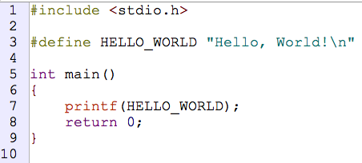
Preprocessor (cont. 1)
Notes:
0205_preprocess/helloWorld.c

Slide 6
Preprocessor (cont. 2)
/code/sre/0205_preprocess/helloWorld.c
gcc -E helloWorld.c -o helloWorld.pp
Notes:
Preprocess this file now

Slide 7
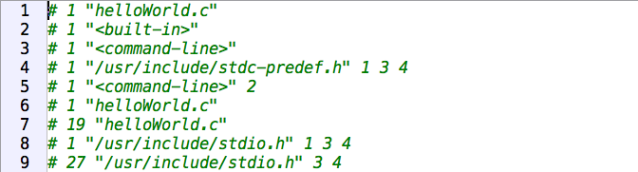
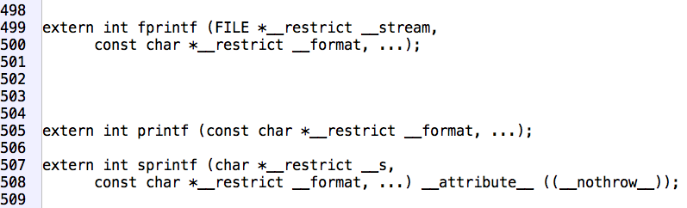
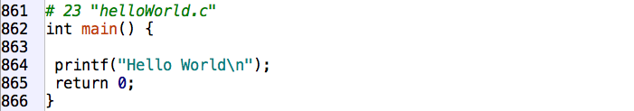
Preprocessor (cont. 3)
Notes:
Result of the preprocessing stage (lots of line omitted here)
505: Function prototype for the printf() function, but lots of other function prototypes also included
864: args to printf() are now the string instead of the defined HELLO_WORLD
<10 lines to almost 1,000

Slide 8
Compiler: General Approach
(return to table of contents)

Slide 9
Compiler (cont. 1)
/code/sre/0210_compile/helloWorld.c
gcc –S helloWorld.c
Notes:
Compile this file now

Slide 10
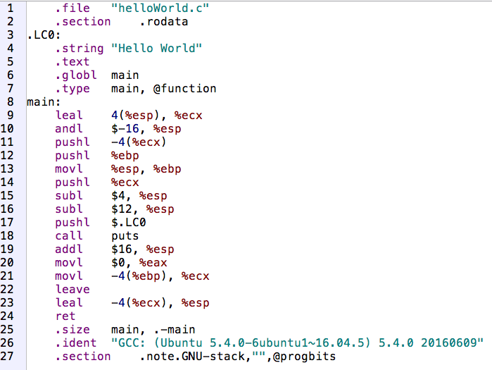
Compiler (cont. 2)
Notes:
Do we recognize anything at all here?
This is AT&T syntax (% before registers, and $ before immediate values, and source->destination)
This was actually built with
gcc -S helloWorld.c -fno-asynchronous-unwind-tables
to create the output without the .cfi_* entries that we can ignore for now. (make no-cfi)

Slide 11
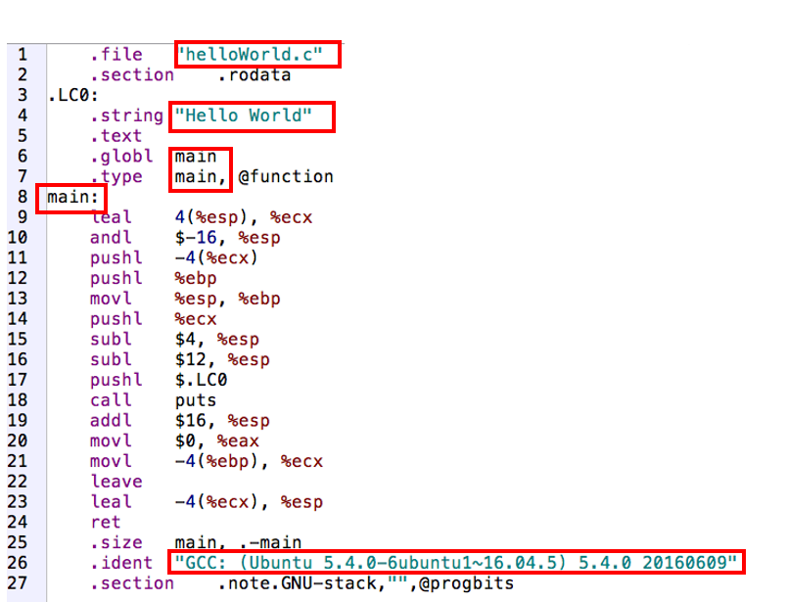
Compiler (cont. 3)
Notes:
Lots of things we recognize (without knowing anything about assembly)

Slide 12
Compiler (cont. 4)
/code/sre/0210_compile/helloWorld.c
gcc -masm=intel -S helloWorld.c
Notes:
We can also generate the intel assembly if we prefer
make intel

Slide 13
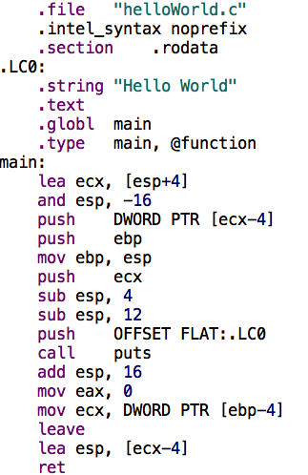
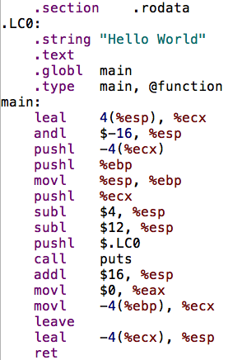
Compiler 5
Notes:
AT&T on the left, and the corresponding Intel syntax on the right

Slide 14
Assembler: General Approach
(return to table of contents)

Slide 15
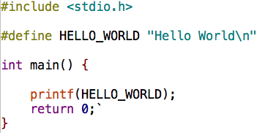
Assembler (cont. 1)
/code/sre/0215_compile/helloWorld.c
gcc -c helloWorld.c
Notes:
Compile and assemble, but do not link
Creates an object file, which will be called helloWorld.o by default

Slide 16
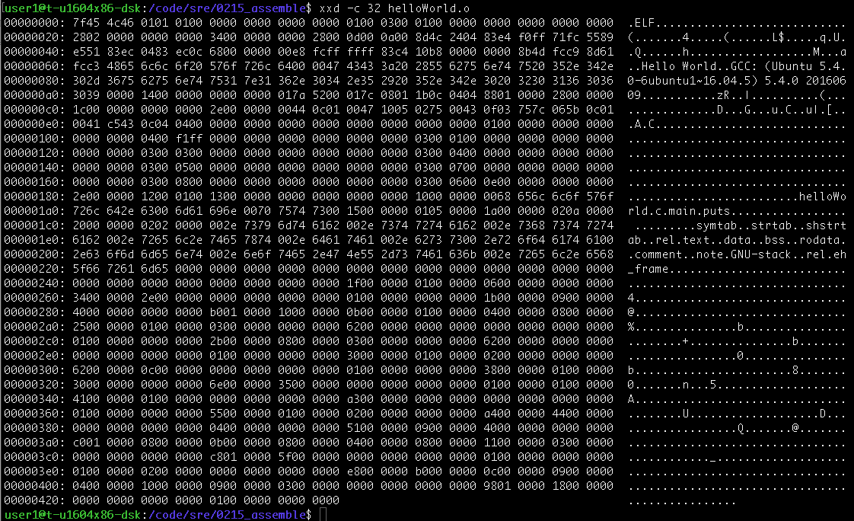
Assembler (cont. 2)
xxd –c32 helloWorld.o
Notes:
Look at helloWorld.o using xxd (as shown here), od, hexdump or bvi
Tough to understand, but we can see a few things we recognize…

Slide 17
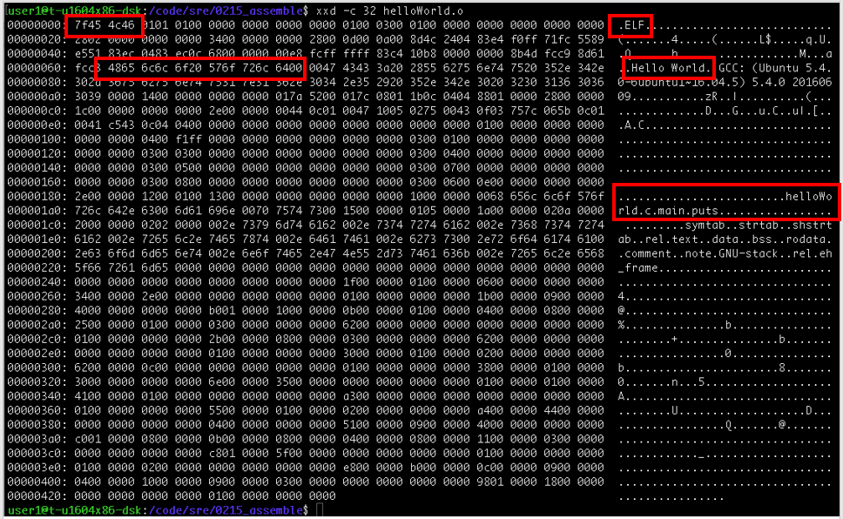
Assembler (cont. 3)
xxd –c32 helloWorld.o
Notes:
Look at helloWorld.o using xxd (as shown here), od, hexdump or bvi
Tough to understand, but we can see a few things we recognize
- ELF magic number (0x7f 0x45 0x4c 0x46). Talk about magic numbers and where/when they are used (including by the file command)
- Hello World string
- helloWorld.c
- main
- GCC (Debian…)

Slide 18
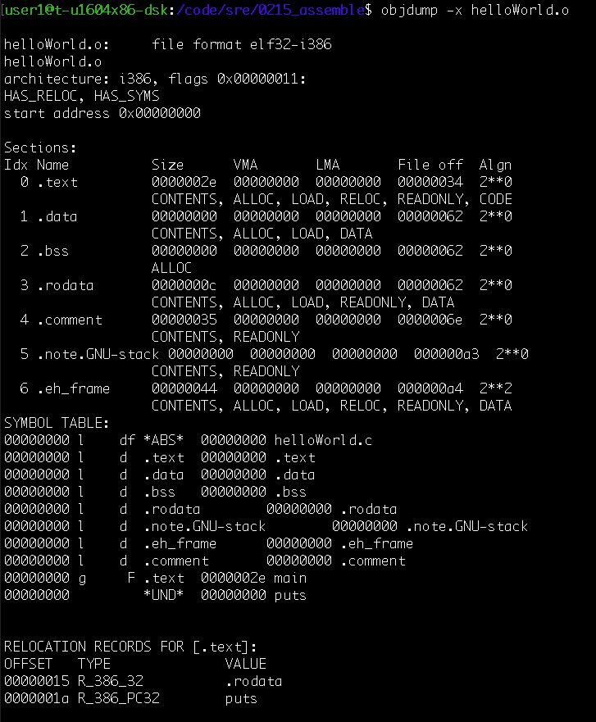
Assembler (cont. 4)
objdump –x helloWorld.o
Notes:
objdump -x helloWorld.o
-x flag: Display all available header information, including the symbol table and relocation entries. Using -x is
equivalent to specifying all of –a –f –h –p –r -t.
Focus should be on all of the things we do recognize here, or can guess the meaning of. Don’t get too sidetracked on the details
Obviously lots of information in this object file, and we can understand a little bit of it.
- .text is the code section
- .data is the initialized data (global and statics)
- .bss is the uninitialized data
- .rodata is the read only data
readelf provides similar information, and is more specific to ELF files (whereas objdump is not ELF specific)

Slide 19
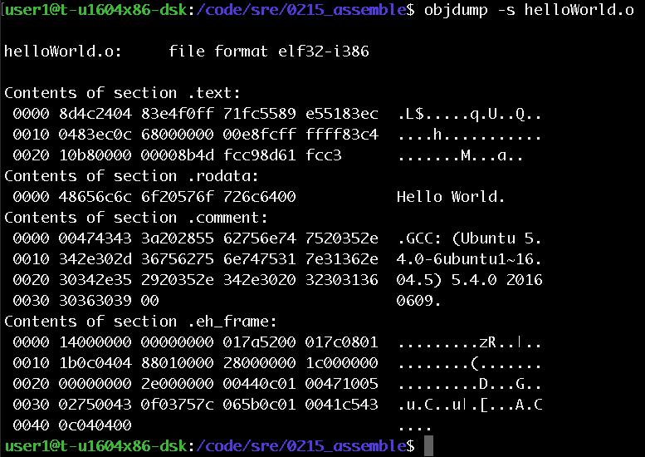
Assembler (cont. 5)
objdump –s helloWorld.o
Notes:
objdump –s helloWorld.o
Display the contents of the sections If we look back at the previous slide we can see that the text section starts at offset 0x34, and if we look back two slides we can see that code (starts with byte 0x8d) at position 0x34
Some of the other sections are also somewhat recognizable

Slide 20
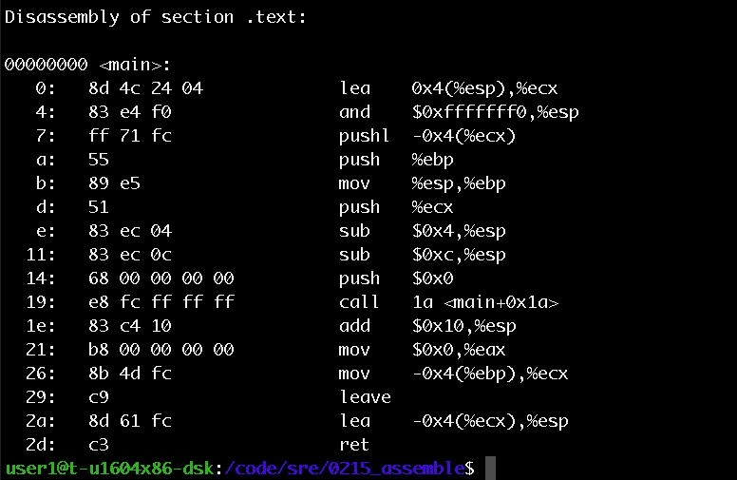
Assembler (cont. 6)
objdump -d helloWorld.o
Notes:
objdump –d helloWorld.o
Disassemble the .text section (or actually any sections that is expected to contain instructions). In this case that’s just the .text section

Slide 21
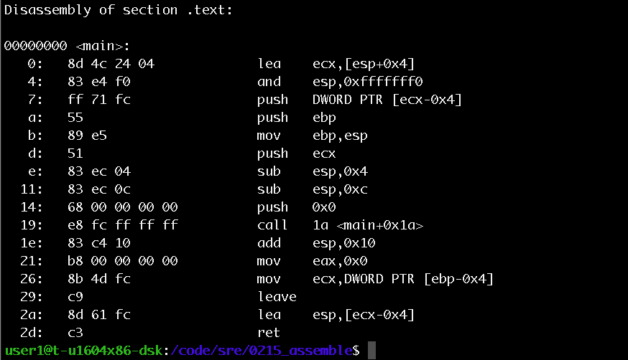
Assembler (cont. 7)
objdump -M intel -d helloWorld.o
Notes:
objdump –d -M intel helloWorld.o
Disassemble the .text section and show the output in intel syntax
So is there anything here we can recognize?

Slide 22
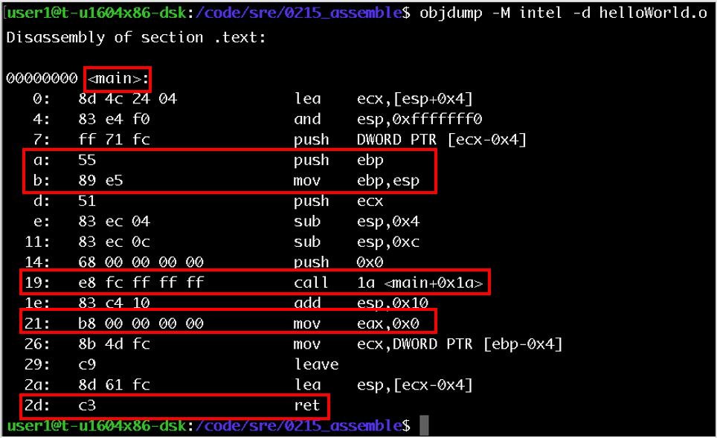
Assembler (cont. 8)
objdump -M intel -d helloWorld.o
Notes:
objdump –d -M intel helloWorld.o
Disassemble the .text section and show the output in intel syntax
So is there anything here we can recognize?
Function prolog (push EBP, mov EBP, ESP)
Call sounds like we’re maybe calling a function
Ret (with mov eax, 0x0 a couple of lines before) maybe seems like we’re returning 0 from main

Slide 23
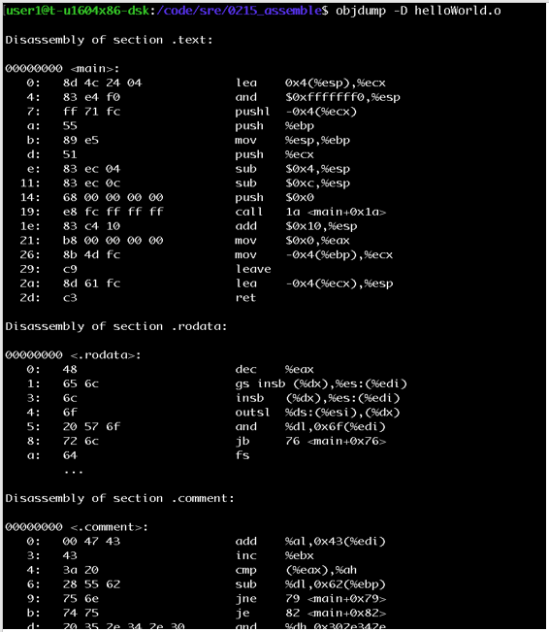
Assembler (cont. 9)
Notes:
If some disassembly is good, more must be better, right?
Disassemble ALL sections – DANGER WILL ROBINSON
objdump –D helloWorld.o
Discuss this as an important issue with SRE (particularly static SRE). It’s hard to figure out what is code and what is not, and simply disassembling it doesn’t necessary help.

Slide 24
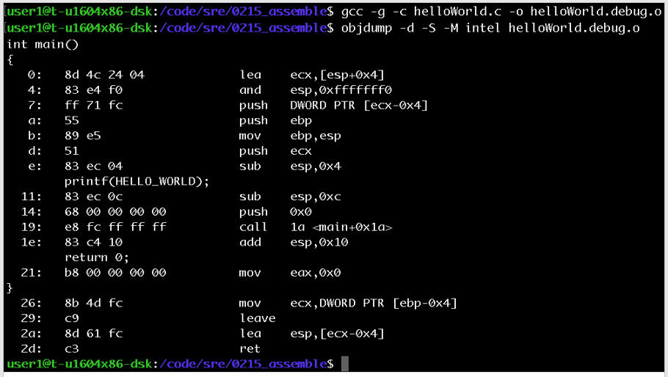
Assembler (cont. 10)
gcc -g -c helloWorld.c -o helloWorld.debug.o
objdump -d -S -M intel helloWorld.debug.o
Notes:
If we compiled we debug information we can also show the source and assembly in the same view

Slide 25
Linker
(return to table of contents)
Notes:
These are the topics that are covered in this lesson.

Slide 26
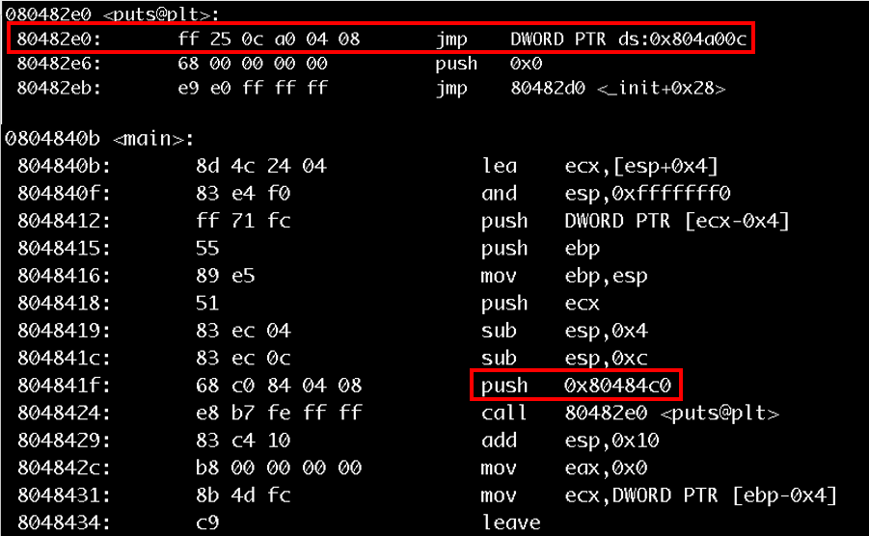
Linker (cont. 1)
gcc helloWorld.c -o helloWorld
objdump -d -M intel helloWorld
Notes:
Complete all four steps including linking at the end
Lots of new information in the binary, and the linker has filled in some of the information it now has about the locations of functions and data
PLT = Procedure Linkage Table
In the compiled (but not linked version 2 slides back the call was to e8 fc ff ff ff ff, and this placeholder has now been replaced with the address of the function placeholder in the PLT. When the binary is loaded (for execution) then the loader will handle finding the correct address of the puts() function in a shared library (actually libc). See the next slide for the relocation section

Slide 27
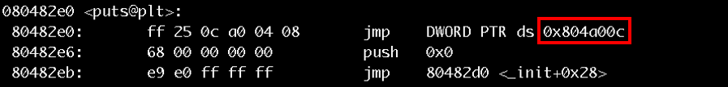
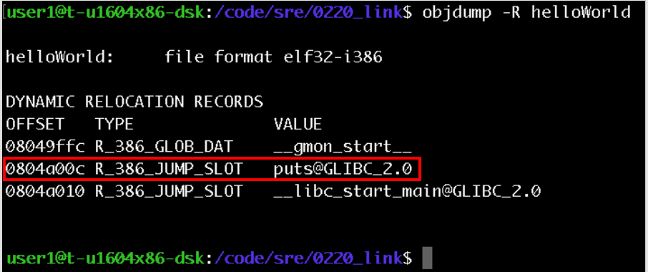
Linker (cont. 2)
objdump -R helloWorld
Notes:
Address 0x804a00c will be filled in by the linker to hold the address of puts in GLIBC

Slide 28
Building Multiple Files

Slide 29
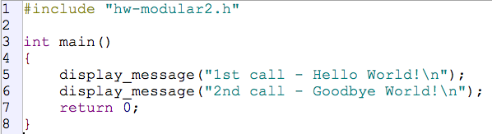
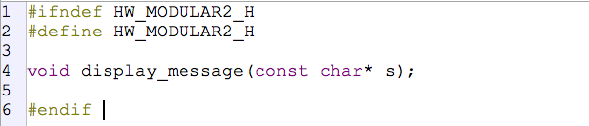
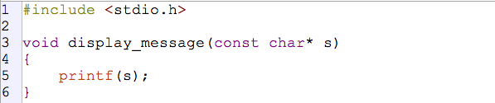
Building Multiple Files (cont. 1)
/code/sre/ 0230_multiple/*
Notes:
Have a look at hw-modular1.c, hw-modular2.c, and hw-modular2.h
Use the tools we have seen so far to have a look at how display_message() is called from main(). How does the .o file look for hw-modular1.o when only it is built, then how does it look once the entire program is linked?

Slide 30
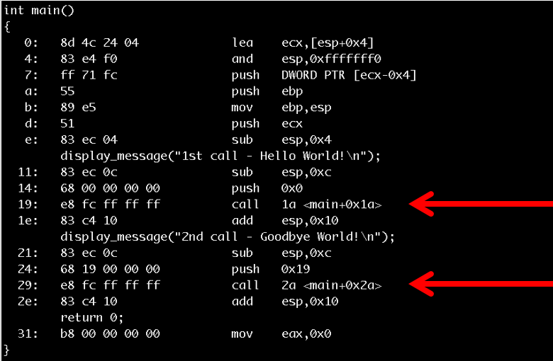
Building Multiple Files (cont. 2)
gcc –g –c hw-modular1.c
objdump –d –S –M intel hw-modular1.o
Notes:
If we just compile hw-modular1.c, then compiler doesn’t know where display_message() is, so it inserts an entry for the linker (or possibly the loader) to figure out later
E8 FC FF FF FF FF (which means “call the function at a offset of FF FF FF FC bytes from EIP”)

Slide 31
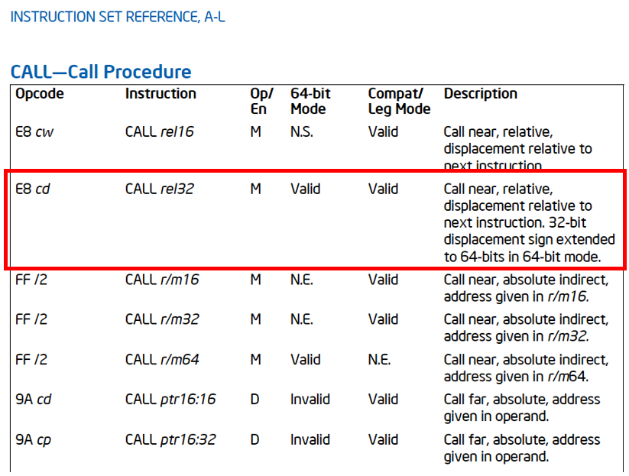
Building Multiple Files (cont. 3)
Notes:
If we just compile hw-modular1.c, then compiler doesn’t know where display_message() is, so it inserts an entry for the linker (or possibly the loader) to figure out later
E8 FC FF FF FF FF (which means “call the function at a offset of FF FF FF FC bytes from EIP”)

Slide 32
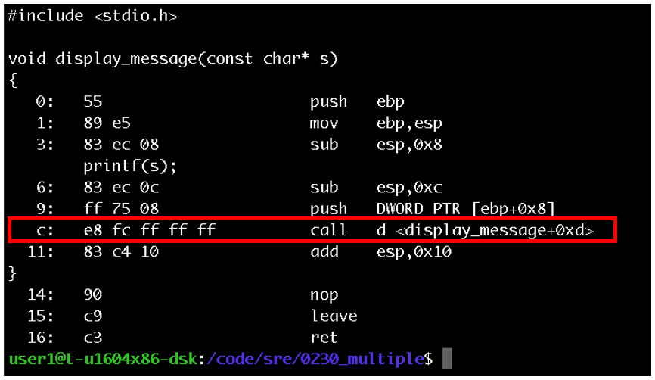
Building Multiple Files (cont. 4)
gcc –g –c hw-modular2.c
objdump –d –S –M intel hw-modular2.o
Notes:
We see a similar issue when we just compile hw-modular2.c (for the call to printf at offset 0x18)

Slide 33
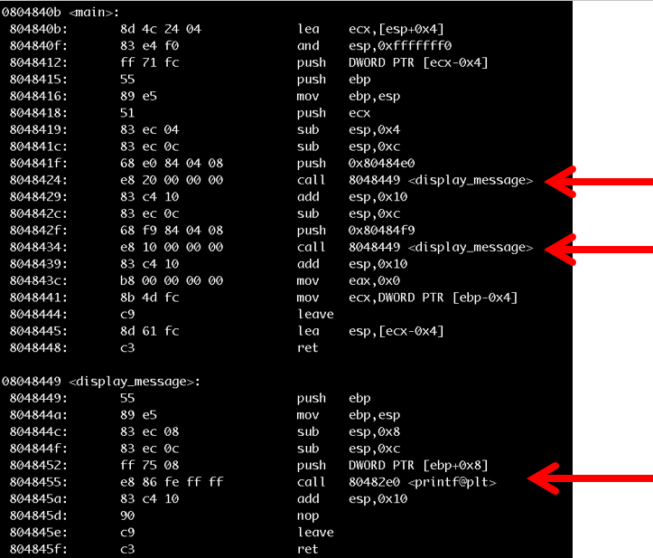
Building Multiple Files (cont. 5)
Notes:
If we compile both together, and let the linker execute, then the object files are updated to include references to the functions that the linker can locate at link time.
gcc –g –o hw-modular hw-modular*.c
objdump –d –S –M intel hw-modular

Slide 34

Forward Engineering

Slide 35
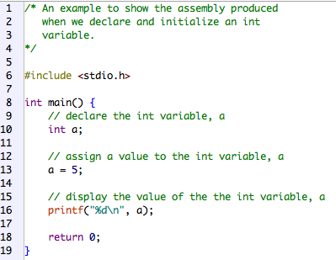
Forward Engineering (cont. 1)
/code/sre/ 0240_forward/ int_var.c
gcc –g –o 010_int_var 010_int_var.c
Notes:
Create and compile a program to show the assembly produced when declaring an int variable then assigning a value to it.
Note that we’re compiling with the debug flag (-g) on

Slide 36
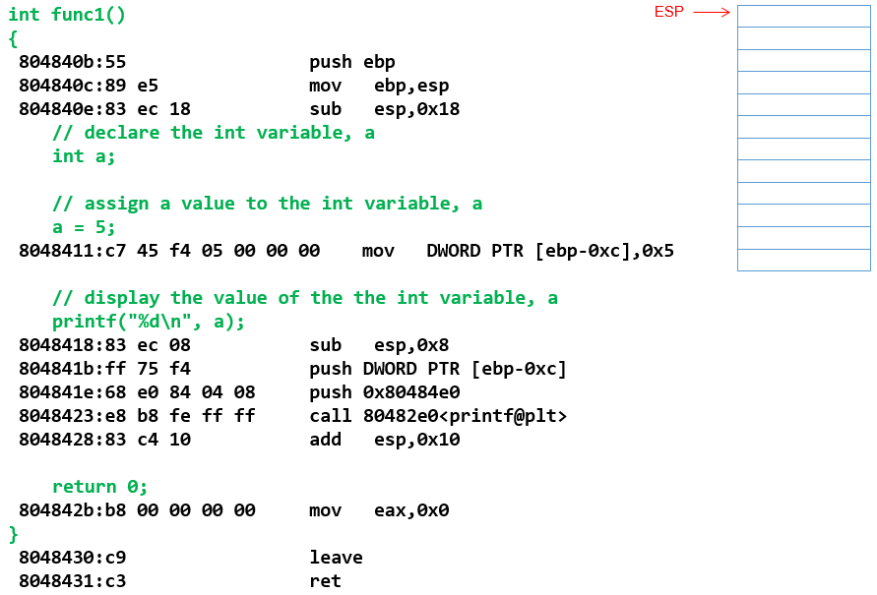
Forward Engineering (cont. 2)

Slide 37
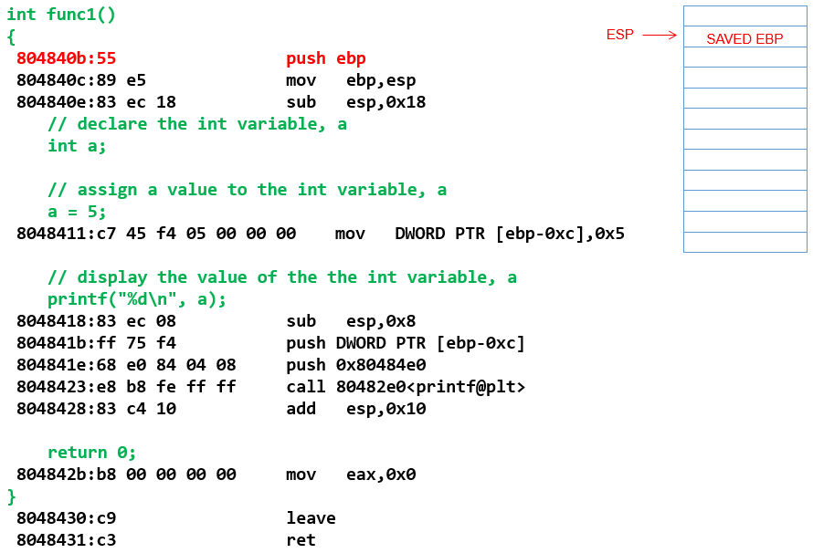
Forward Engineering (cont. 3)

Slide 38
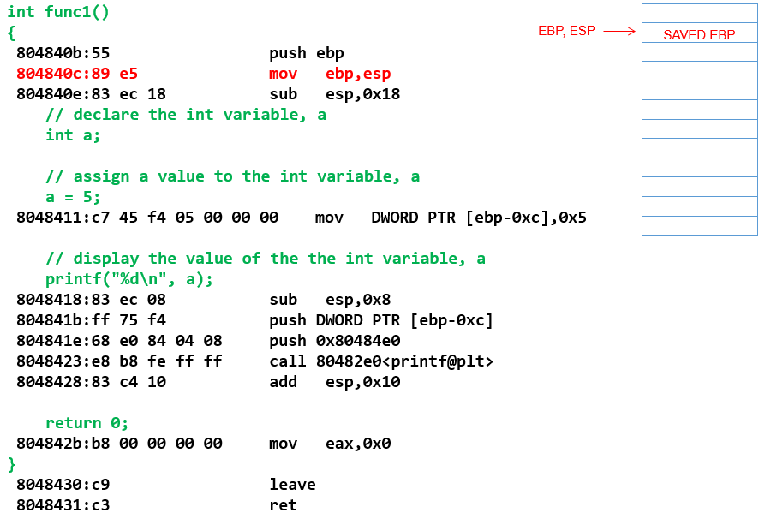
Forward Engineering (cont. 4)

Slide 39
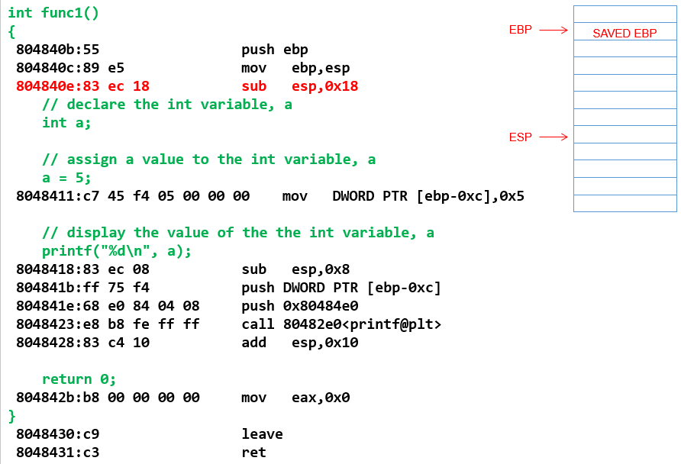
Forward Engineering (cont. 5)

Slide 40
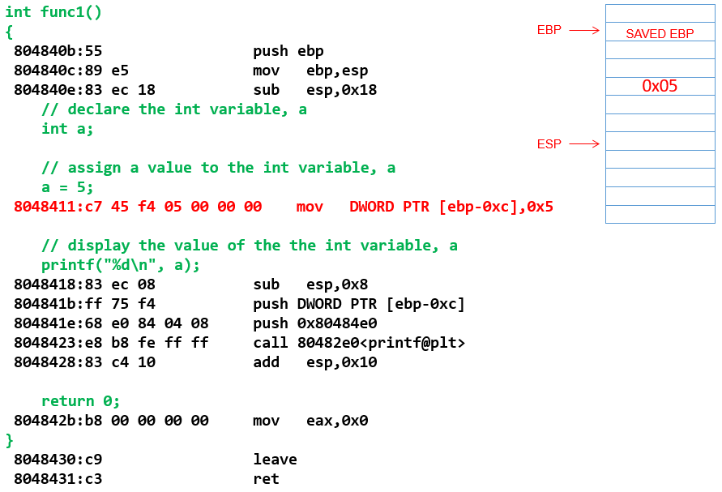
Forward Engineering (cont. 6)

Slide 41
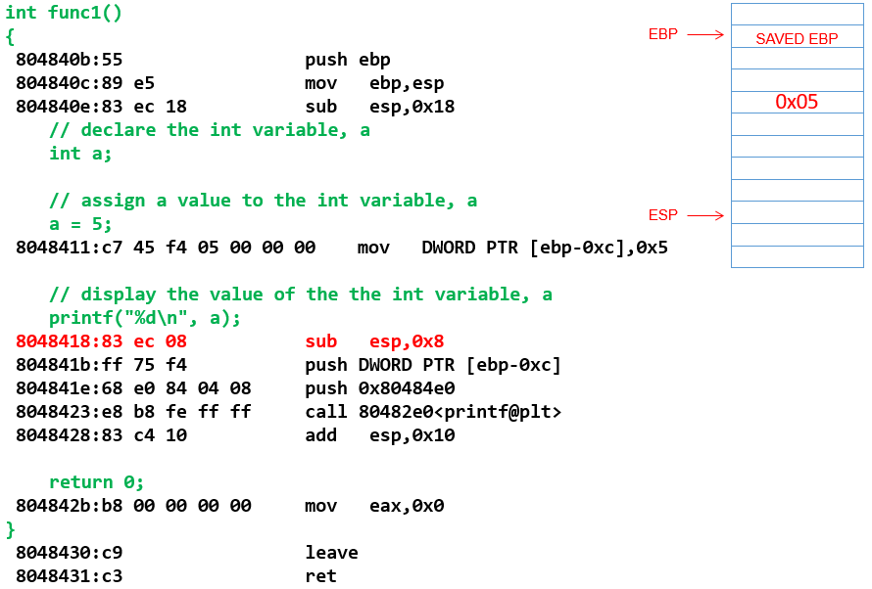
Forward Engineering (cont. 7)

Slide 42
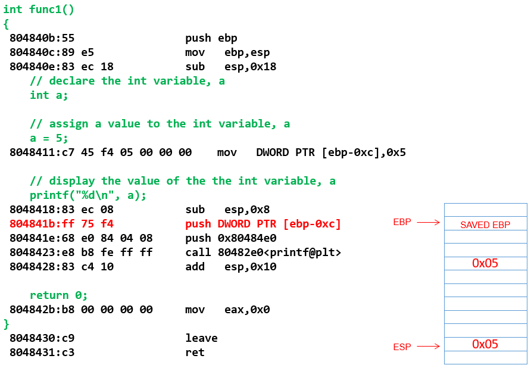
Forward Engineering 8

Slide 43
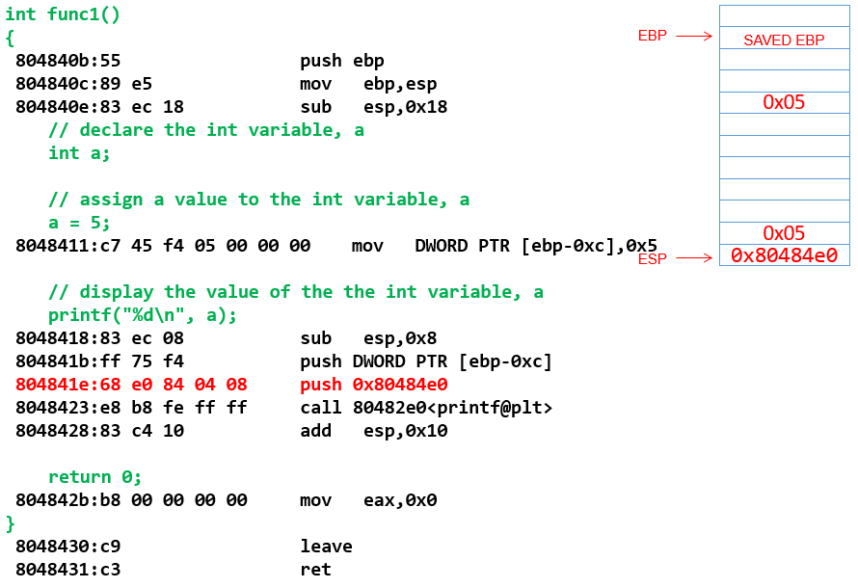
Forward Engineering (cont. 8)
Notes:
Just pushed the params to printf onto the stack (in reverse order so that when they get popped back off the stack they are in the correct order

Slide 44
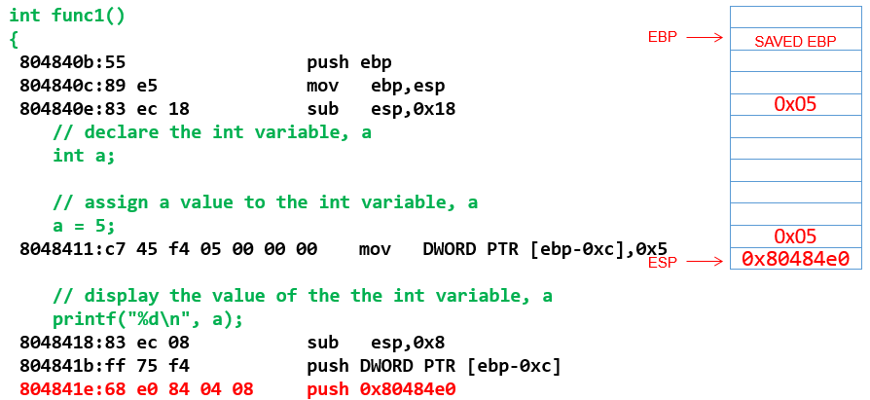
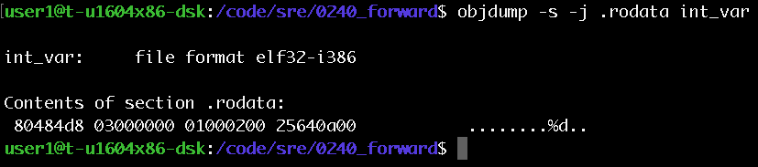
Forward Engineering (cont. 9)
Notes:
Confirmation that 0x080484e0 is the format string “%d\n\0”

Slide 45
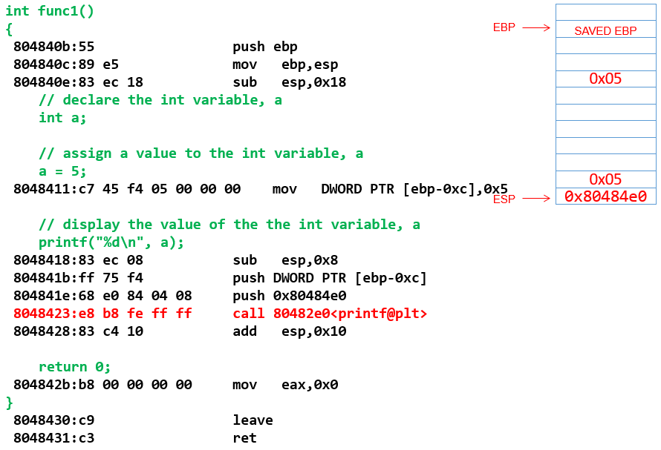
Forward Engineering (cont. 10)
Notes:
Printf does its thing

Slide 46
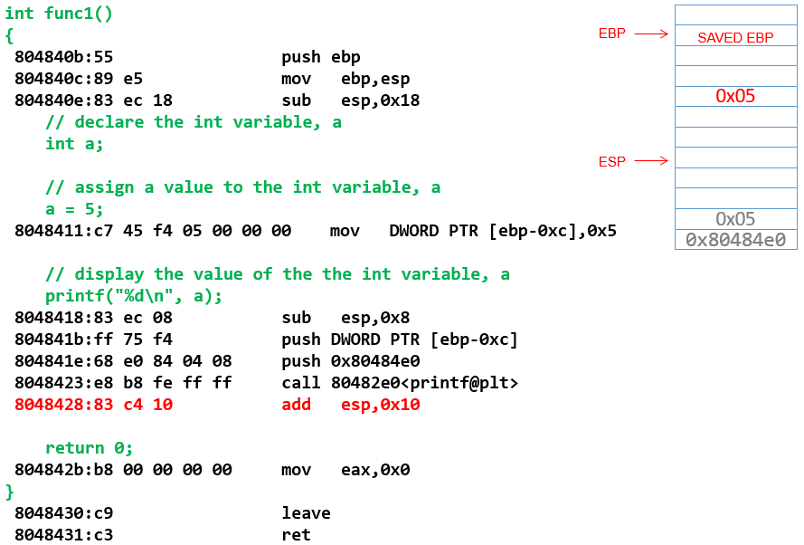
Forward Engineering (cont. 11)
Notes:
Printf does its thing

Slide 47
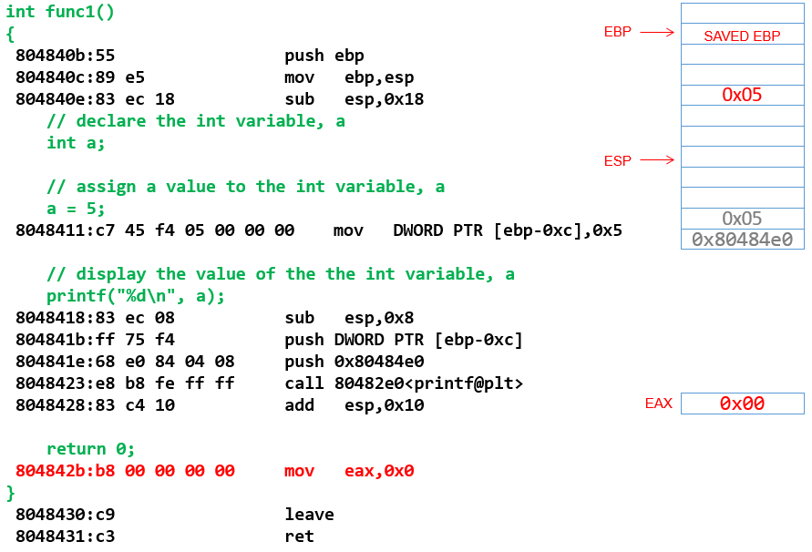
Forward Engineering (cont. 12)
Notes:
Printf does its thing

Slide 48
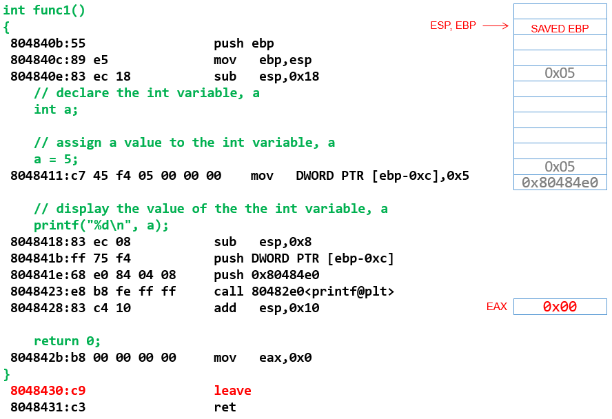
Forward Engineering (cont. 13)
Notes:
Leave is equivalent to
mov esp, ebp
pop ebp

Slide 49
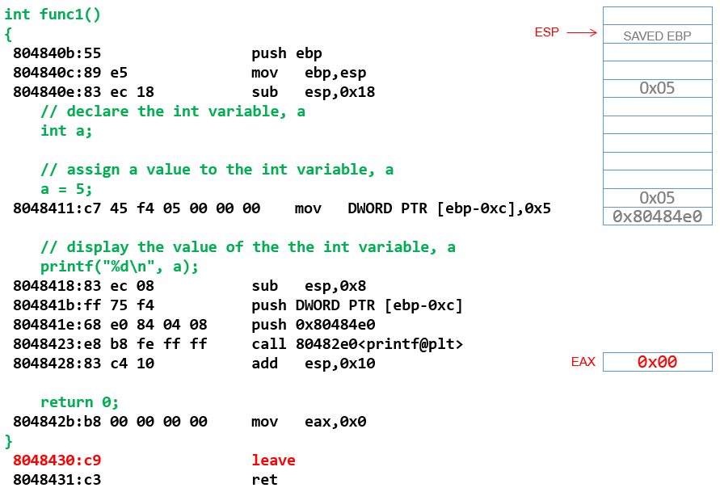
Forward Engineering (cont. 14)
Notes:
Leave is equivalent to
mov esp, ebp
pop ebp

Slide 50

Forward Engineering (cont. 15)
Notes:
Return to caller

Slide 51
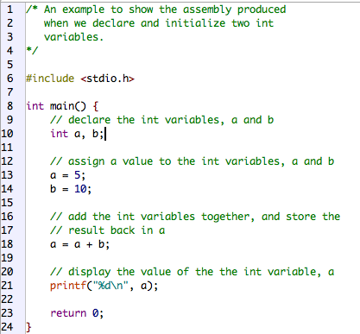
Forward Engineering 17
/code/sre/ 0240_forward/ int_var_x_2.c
Notes:
Work through the same process for this slightly more complex program

Slide 52
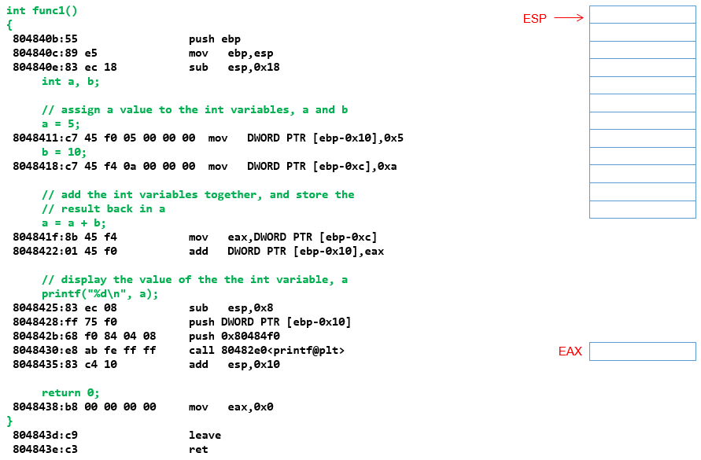
Forward Engineering (cont. 17)
Notes:
Start of func1()

Slide 53
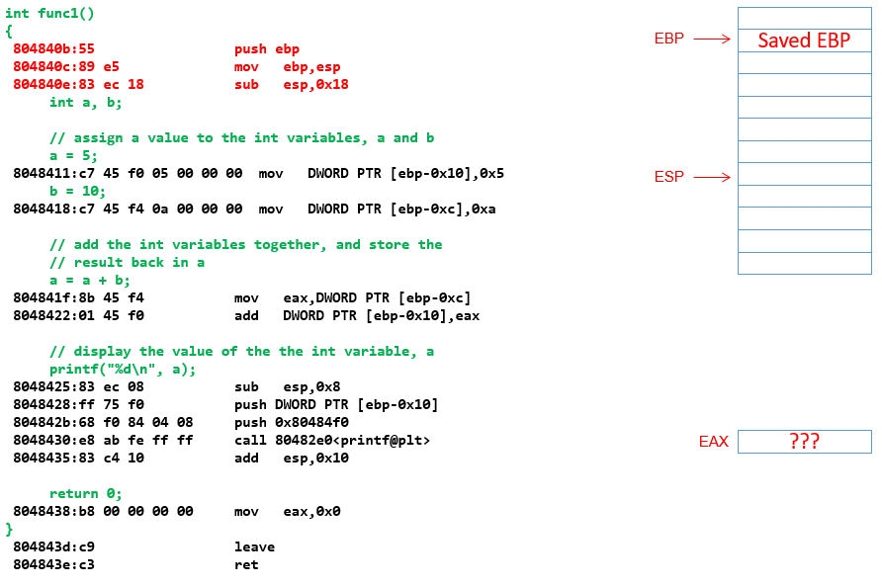
Forward Engineering (cont. 19)
Notes:
After the function prolog instructions have executed

Slide 54
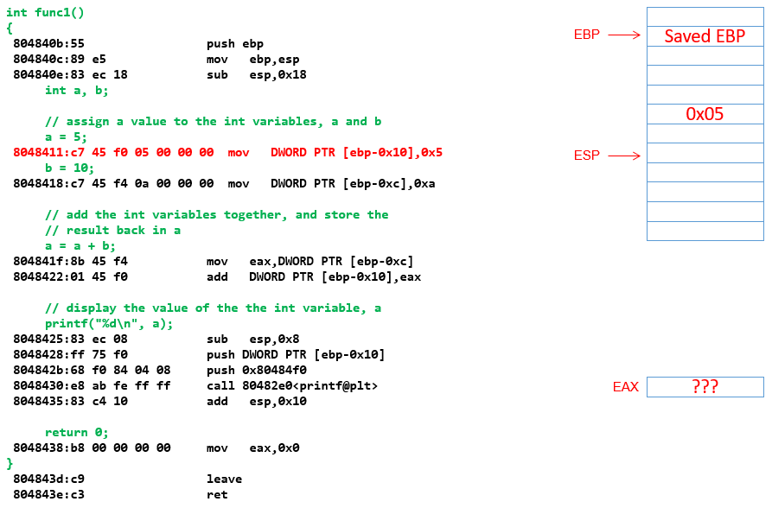
Forward Engineering (cont. 20)
Notes:
Local variable a initialized

Slide 55
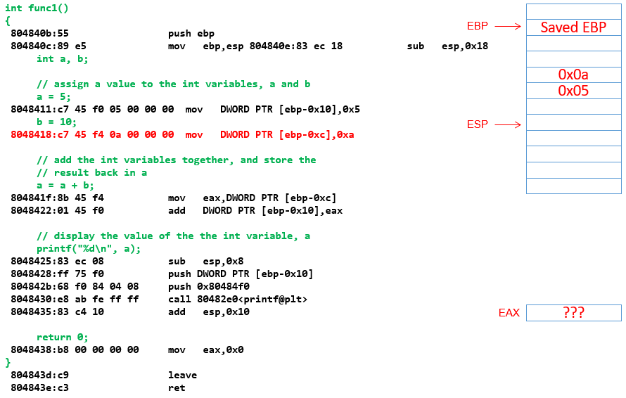
Forward Engineering (cont. 21)
Notes:
Local variable b initialized on the stack

Slide 56
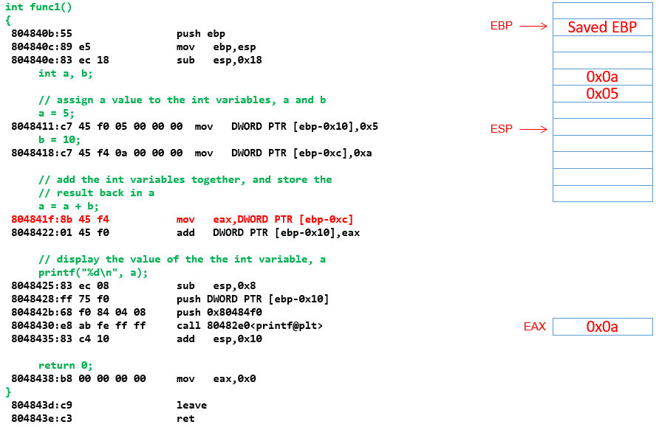
Forward Engineering (cont. 22)
Notes:
Value of local variable a moved into EAX (start of addition operation from C code)

Slide 57

Forward Engineering (cont. 23)
Notes:
Value in EAX added to the existing value in local variable a

Slide 58

Forward Engineering (cont. 24)
Notes:
ESP changed prior to pushing arguments for printf()

Slide 59

Forward Engineering (cont. 25)
Notes:
printf() arguments pushed onto the stack

Slide 60

Forward Engineering (cont. 26)
Notes:
Return to caller

Slide 61

Forward Engineering (cont. 27)
Notes:
Stack unwinding after call to prinft()

Slide 62

Forward Engineering (cont. 28)
Notes:
Return value from func1() moved into EAX

Slide 63

Forward Engineering (cont. 29)
Notes:
Return to caller

Slide 64
Summary
We have covered the main concepts associated with the build process including:
Preprocessors
Compilers
Assemblers
Linkers
RE is much easier if you are comfortable identifying the language structures in assembly language.
Notes:
This section provides a summary of the key points of the lessons and the expected capabilities that students should master before moving on to the next section

